Slide 1

INSPIRE Good Practice – Data-Service Linking Simplification
MIG-T Sub-group 2.3.2
Antonio Rotundo, Ine de Visser, Marie Lambois, Heidi Vanparys
JRC INSPIRE Team
Jordi Escriu, Davide Artasensi, Marco Minghini, Alexander Kotsev
INSPIRE Good Practice – Data-Service Linking Simplification Webinar November 21st, 2022

Slide 2
Programme
Welcome
Introduction ‘Data-Service Linking Simplification good practice’
Implementations and support evidences
Q/A session & Discussion
Conclusions and next steps

Slide 3
Introduction ‘Data-Service Linking Simplification good practice’
Context - MIWP Action 2.3.2
Intended outcomes
Summary of work
Overview of the Data-service linking simplification specification
Part A: Data-Service Linking Simplification
Part B: Use of INSPIRE conformant standard capabilities documents
Limitations

Slide 4
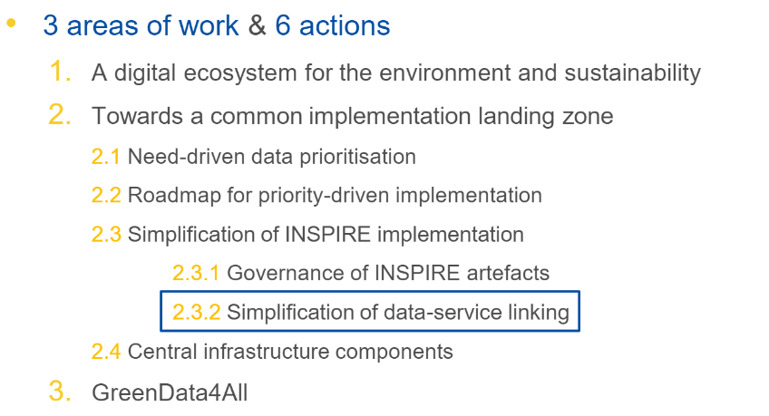
Context - workprogram
INSPIRE MIWP 2021-2024

Slide 5
Context - MIWP Action 2.3.2
Kick-off March 4th 2021
Participants from AT, DE, DK, EL, ES, FR, IT, LT, NL, PL, SE, SK
Starting from discussion paper created by action 2019.2
The initial version of the paper was drafted by a small MIG-T ad-hoc group with members from DK, FR, NL, JRC and DG ENV, 2018
The sub-group will work on the following activities:
Develop an approach for simplification of data and service linking
Validate the proposed technical approach with widely used web applications
Follow the procedure for submitting an INSPIRE Good practice

Slide 6
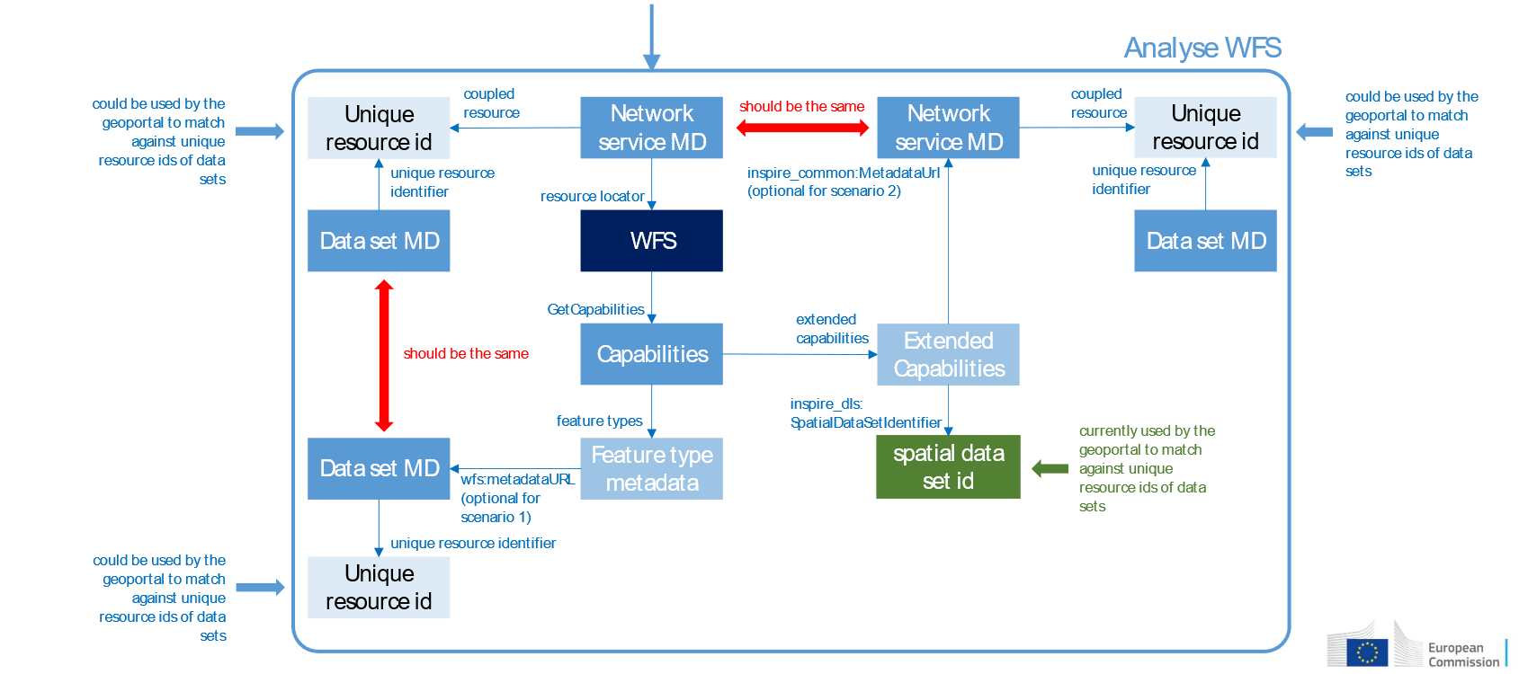
Current data – service linking approach

Slide 7
Context - the issues (52nd MIG-T meeting)
the level of data-service linking in INSPIRE is insufficient, and many organisations seem to have difficulties to provide implementations in line with the current TGs (even though almost all MS provide at least some data sets with correct data-service linking);
this already has negative impacts on the accessibility of INSPIRE data sets (through the INSPIRE geoportal) and hence the overall usability of the INSPIRE infrastructure;
this will also lead to poor indicators in the future (metadata-based) approach for monitoring and reporting;
the current approach for data-service linking described in the TGs for metadata and network services is complicated, and there are different interpretations of the related requirements, even by implementation/standards experts;
the current approach for service metadata, which requires extensions to base standards, is posing an obstacle to the implementation of INSPIRE requirements for network services (because the required extensions are not widely implemented in off-the-shelf software); and
there is a clear overlap / duplication of data set and service metadata (e.g. bounding box, INSPIRE theme), which in some cases leads to inconsistencies.

Slide 8
Context – recommendations (52nd MIG-T meeting)
The MIG-T supports the new data-centric approach (already underlying the new geoportal and the proposed revision of the M&R IRs), which focuses on data and how they can be accessed through network services rather than considering data and network services as stand-alone components of the infrastructure. However, it might still be useful for application developers to be able to access a directory/register of the services available in the infrastructure.
The MIG-T further recommends that there should be one "source of truth" for service metadata, ideally as provided by the service itself (e.g. in its Capabilities document).
The alternative approach for documenting data-service linking in the data set metadata (as proposed in the discussion paper) should be further elaborated and become the preferred option in the Metadata TGs (and/or in a stand-alone guidance document on data-service linking); this guidance should include an explanation how the IR requirements for network service metadata are mapped to the new approach;
The current approach should still be supported for a transition period (to be determined by the MIG) as an alternative option that will be used by the geoportal if no links to network services can be established based on the data set metadata; at the end of the transition period the necessity to further support the current approach should be reviewed;

Slide 9
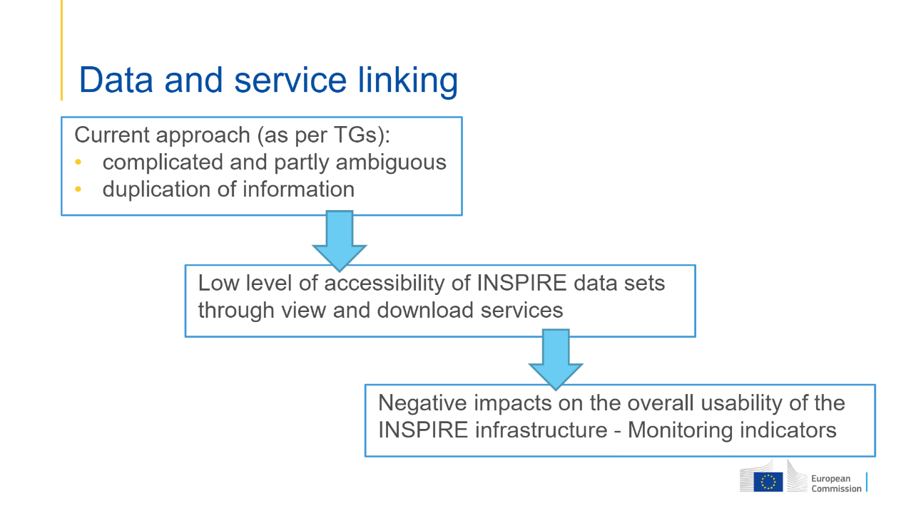
Context - the issue

Slide 10
Intended outcome (1)
The users of the INSPIRE infrastructure can access all available data via the view and download services. When using this GP, data providers are not experiencing difficulties anymore to establish downloadable and viewable data sets, because:
The requirements described in this good practice for documenting these links are easy to be implemented and understood, and therefore widely used and correctly implemented by MS.
INSPIRE-specific extensions to existing standards that are not widely supported by existing software products. This GP makes them unnecessary from now onwards, since it allows implementer's organizations to access off-the-shelf software without worrying anymore about compliance to INSPIRE-specific extensions.

Slide 11
Intended outcome (2)
The duplication of metadata information is reduced. Only one metadata record is required per data set, avoiding the need for documenting additional service metadata records (view, download and possibly direct access / WFS). Only the Capabilities document and service feed for ATOM's are used to document the service metadata, removing possible inconsistencies.
The amount of metadata in the INSPIRE Geoportal and the national geoportals could be reduced, making search easier and reducing the size of information to be stored and indexed.
For client applications, it becomes easier to implement discovery of and access to data sets. This helps implementers to focus on INSPIRE specificity following a data-centric approach, rather than devoting excessive time to documenting the resources, mainly services, and configuring them properly.

Slide 12
Summary of work
This good practice constitutes an alternative way to provide the data-service linking in INSPIRE - Optional, not mandatory.
The data set metadata record shall include additional elements, already present in many national metadata profiles, related to view and download services;
There is no need for view and download services to be documented through their stand-alone service metadata records. The metadata returned by the service itself, as a response to a Get View/Download Service Metadata request, is enough to provide the required information;
The metadata returned by the OGC web services (OWS) can follow a structure supported by all implementing servers, no longer including the Extended Capabilities section (an optional element not supported by all implementing servers).

Slide 13

MIWP Action 2.3.2 Data Service Linking Simplification - Overview
Section 8
Data set metadata
Service metadata
Part A. Data - service linking simplification
Good practice guidelines
OperatesOn
Service URL
ID DATASET
Get
Capabilities
Section 9
Service metadata URL
Part B. Data - service linking simplification
Use of INSPIRE conformant standard capabilities documents
INSPIRE extended capabilities
Data set metadata URL
Layers
Final specification:
https://github.com/INSPIRE-MIF/gp-data-service-linking-simplification/blob/main/good-practice/data-service-linking-simplification-spec.md
Notes:
The main message is that ...

Slide 14
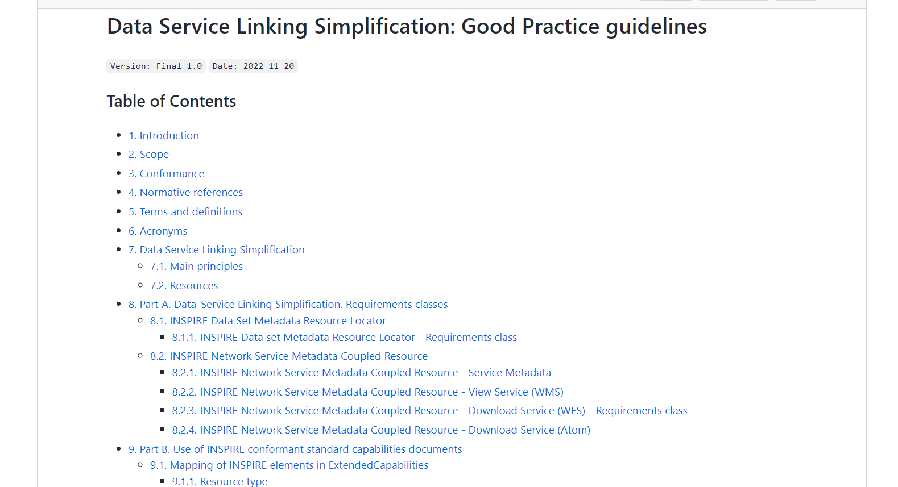
Part A: Data-Service Linking Simplification
https://github.com/INSPIRE-MIF/gp-data-service-linking-simplification/blob/main/good-practice/data-service-linking-simplification-spec.md#8-part-a-data-service-linking-simplification-requirements-classes-

Slide 15
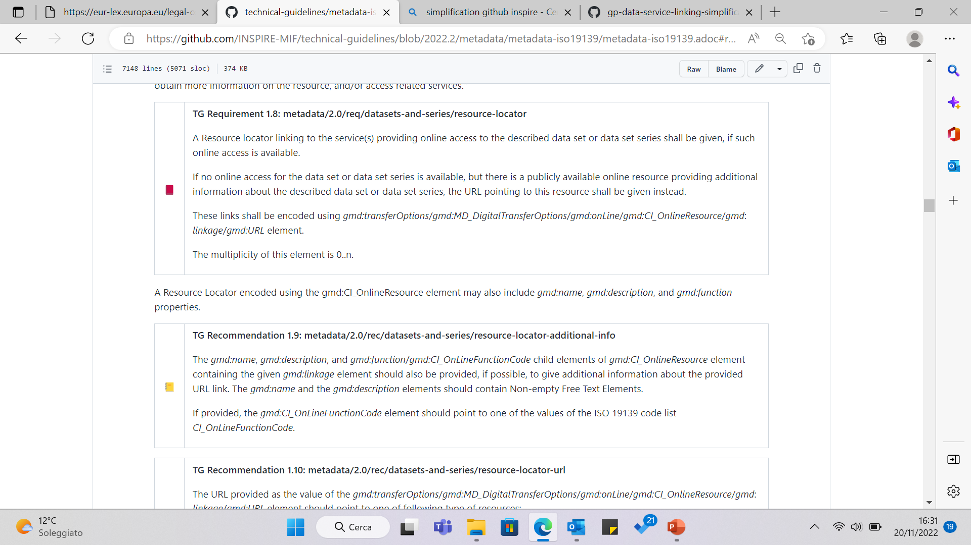
Part A: Data-Service Linking Simplification
Data set metadata
Service metadata
OperatesOn
Current approach
Service URL
ID DATASET
View and Download services are required to make data sets available; this implies that at least two locators need to be expressed in the data set metadata

Slide 16
Part A: Data-Service Linking Simplification
Simplification approach (resource locator)
Data set metadata
Service metadata
OperatesOn
Service URL
In case of View and Download services, for the resource locator:
the element gmd:URL SHALL point to the response of the Get View/Download Service Metadata (GetCapabilities);
the elements gmd:protocol and gmd:applicationProfile SHALL be present
ID DATASET
metadata element | Encoding
<gmd:protocol> | gmx:Anchor pointing to the URI coming from https://inspire.ec.europa.eu/metadata-codelist/ProtocolValue
 | gco:CharacterString with the value of the label in the metadata language
<gmd:applicationProfile> | gmx:Anchor pointing to the URI https://inspire.ec.europa.eu/metadata-codelist/SpatialDataServiceType/view or https://inspire.ec.europa.eu/metadata-codelist/SpatialDataServiceType/download
Resource Locator | gco:CharacterString with the value of the label in the metadata language

Slide 17
Part A: Data-Service Linking Simplification
Example for a view service
<gmd:transferOptions>
<gmd:MD_DigitalTransferOptions>
<gmd:onLine>
<gmd:CI_OnlineResource>
<gmd:linkage>
<gmd:URL>https://geoservizi.regione.liguria.it/geoserver/M1743/wms?version=1.3.0&request=getcapabilities</gmd:URL>
</gmd:linkage>
<gmd:protocol>
<gmx:Anchor xlink:href="http://www.opengis.net/def/serviceType/ogc/wms">OGC Web Map Service</gmx:Anchor>
</gmd:protocol>
<gmd:applicationProfile>
<gmx:Anchor xlink:href="http://inspire.ec.europa.eu/metadata-codelist/SpatialDataServiceType/view">consultazione</gmx:Anchor>
</gmd:applicationProfile>
</gmd:CI_OnlineResource>
</gmd:onLine>
</gmd:MD_DigitalTransferOptions>
</gmd:transferOptions>

Slide 18
Part A: Data-Service Linking Simplification
Example for a download service
<gmd:transferOptions>
<gmd:MD_DigitalTransferOptions>
<gmd:onLine>
<gmd:CI_OnlineResource>
<gmd:linkage>
<gmd:URL>https://geoservizi.regione.liguria.it/geoserver/M1241/wfs?version=2.0.0&request=getcapabilities</gmd:URL>
</gmd:linkage>
<gmd:protocol>
<gmx:Anchor xlink:href="http://www.opengis.net/def/serviceType/ogc/wfs">OGC Web Feature Service</gmx:Anchor>
</gmd:protocol>
<gmd:applicationProfile>
<gmx:Anchor xlink:href="http://inspire.ec.europa.eu/metadata-codelist/SpatialDataServiceType/download">scaricamento</gmx:Anchor>
</gmd:applicationProfile>
</gmd:CI_OnlineResource>
</gmd:onLine>
</gmd:MD_DigitalTransferOptions>
</gmd:transferOptions>

Slide 19
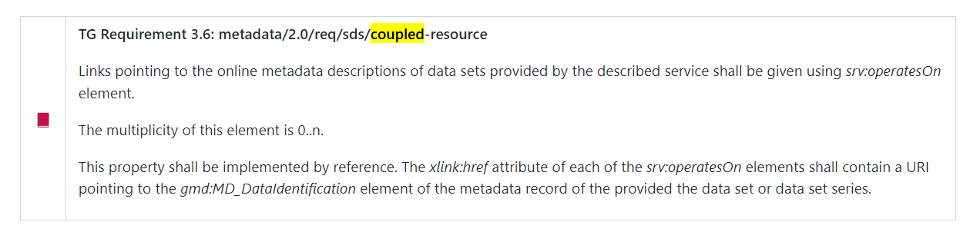
Part A: Data-Service Linking Simplification
Data set metadata
Service metadata
OperatesOn
Current approach
Service URL
ID DATASET

Slide 20
Part A: Data-Service Linking Simplification
Simplification approach (coupled resources)
Data set metadata
Service metadata
OperatesOn
relax the implementation of the Coupled Resource by making the linkage to the <gmd:MD_DataIdentification> element of the data set metadata an optional feature, just pointing to the URL of the metadata
Service URL
ID DATASET
New wording of the
TG Requirement 3.6
metadata element | Encoding
<wms:MetadataURL> (in Layer) | pointing to the metadata record of the provided data set or data set series, available in a Discovery Service catalog
<wfs:MetadataURL> (in Feature type) | pointing to the metadata record of the provided data set or data set series, available in a Discovery Service catalog
/feed/entry/link | containing a link to a data set metadata record with attributes @rel="describedby" and @type=«application/xml»

Slide 21
Proposed data – service linking approach
INSPIRE Model: Simplified ([M] only)
[M] Resource Locator
Service MD in Download/View Service [M]
Dataset MD in Discovery Service [M]
General Service MD [M]
Layer / FeatureType / Entry [M]
[M] Coupled Resource

Slide 22
INSPIRE Model: Simplified
[O] Coupled Resources
[M] Resource Locator
Service MD in Discovery Service [O]
Service MD in Download/View Service [M]*
Dataset MD in Discovery Service [M]
General Service MD [M]
[O] INSPIRE compliant Service MD
INSPIRE Ext MD [O]
LEGEND:
[M]: Mandatory
[O]: Optional
NOTE:
[O] Spatial Dataset Identifier
Layer / FeatureType / Entry [M]
[M] Coupled Resource
Regarding the INSPIRE compliant Service MD - In an INSPIRE Network Service Scenario 1 implementation, the Service MD will not contain all INSPIRE metadata elements but contain a link to the Service MD in the Discovery Service; An Scenario 2 implementation have no separate Service MD in the Discovery Service. Instead, all metadata elements are provided in the extended capabilities section of the capabilities document of the service; An Scenario 3 implementation (new scenario considered if the good practice candidate on Data-Service Linking Simplification is endorsed) also have no separate Service MD in the Discovery. Instead, the metadata elements are remapped to existing elements in the capabilities document of the service and in the dataset metadata.
Regarding the Spatial Data Set Identifier - The IR on Metadata is not including the Unique resource identifier as a required metadata element to be applied to services. The TG for Download and View services specify a WxS/Atom metadata element that contains the Unique Resource Identifier of the Spatial Data Set. In the current INSPIRE Geoportal this is used, in some cases, to establish a link between data and service for quality control purposes. The Coupled resource would be enough for data-service linking purposes, as is used e.g. in case of a WMS in the current INSPIRE Geoportal.

Slide 23
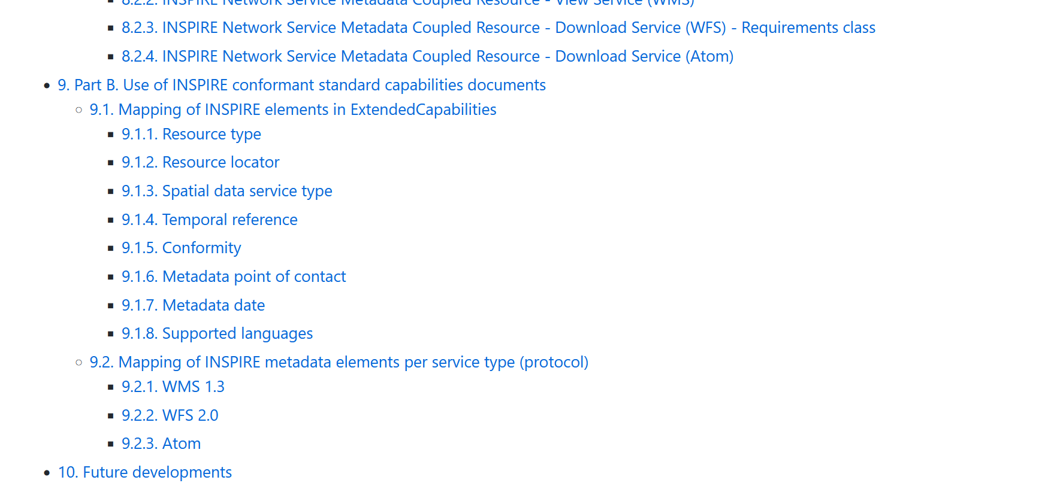
Part B: Use of INSPIRE conformant standard capabilities documents
https://github.com/INSPIRE-MIF/gp-data-service-linking-simplification/blob/main/good-practice/data-service-linking-simplification-spec.md#9-part-b-use-of-inspire-conformant-standard-capabilities-documents-

Slide 24
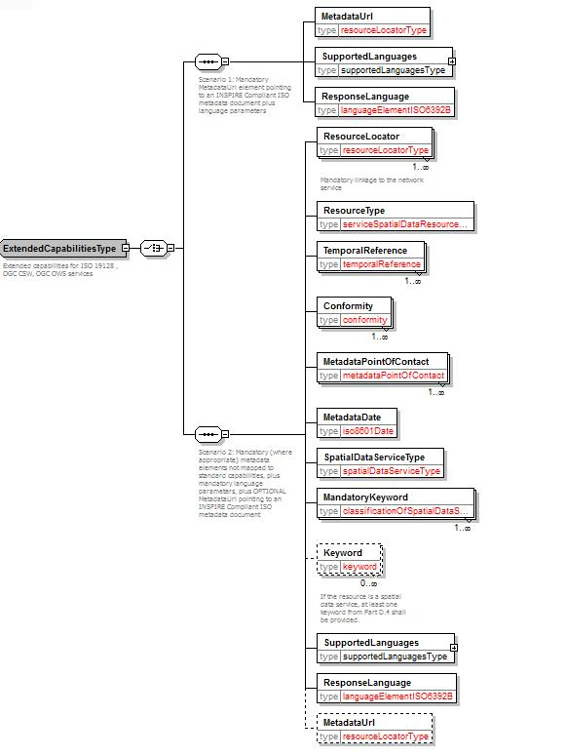
Part B: Use of INSPIRE conformant standard capabilities documents

Slide 25
Part B. Remapping of Extended Capabilities Aim of the work
Define an alternative mapping of INSPIRE service metadata elements to elements available in the Capabilities document of OGC OWS standard services (WMS, WFS) and Atom feeds.
Avoid (as an option) the need for the INSPIRE Extended Capabilities section.
Remove remaining obstacles in the implementation of INSPIRE requirements for network services due to the extensions required to software tools available in the market.
Notes:
The main message is that ...

Slide 26
Part B. Remapping of Extended Capabilities
Resource Type and Resource Locator
Current mapping (in INSPIRE NS - View/Download Service TGs)
INSPIRE metadata elements | Elements of INSPIRE Extended Capabilities/Atom feed | Applicable on Service type
Resource Type | inspire_common:ResourceType | WMS - WFS
Resource Type | not mapped | Atom
Resource Locator | inspire_common:ResourceLocator | WMS - WFS
Resource Locator | Feed level link in the top Atom feed /feed/link[@rel="self"] | Atom
Agreed new mapping
INSPIRE metadata elements | New allocation | Applicable on Service type
Resource Type | No element mapped | WMS - WFS - Atom
Resource Locator | No element mapped | WMS - WFS - Atom
In case of view and download services, when the service metadata is provided as response to a Get Download/View Service Metadata request, then the resource type is implicit and shall not be documented.
Notes:
The main message is that ...

Slide 27
Part B. Remapping of Extended Capabilities
Spatial data service type
Current mapping (in INSPIRE NS - View/Download Service TGs)
INSPIRE metadata elements | Elements of INSPIRE Extended Capabilities/Atom feed | Applicable on Service type
Spatial Data Service Type | inspire_common:SpatialDataServiceType | WMS - WFS
Spatial Data Service Type | not mapped | Atom
Agreed new mapping
INSPIRE metadata elements | New allocation | Applicable on Service type
Spatial Data Service Type | gmd:applicationProfile element (in data set metadata record) | WMS - WFS - Atom
D
Notes:
The main message is that ...

Slide 28
Part B. Remapping of Extended Capabilities
Temporal reference
Current mapping (in INSPIRE NS - View/Download Service TGs)
INSPIRE metadata elements | Elements of INSPIRE Extended Capabilities/Atom feed | Applicable on Service type
Temporal Reference | inspire_common:TemporalReference | WMS - WFS
Temporal Reference | not mapped | Atom
Agreed new mapping
INSPIRE metadata elements | New allocation | Applicable on Service type
Temporal Reference | updateSequence attribute in the WMS_Capabilities/WFS_Capabilities root element. | WMS - WFS
Temporal Reference | feed/updated element in the Atom feed | Atom
Temporal Reference | Otherwise, gmd:citation/gmd:CI_Citation/gmd:date/gmd:CI_Date/gmd:date element in the data set metadata record, with one of the following prioritised date types:- publication, - revision or - creation | WMS – WFS - Atom
S
S
D
Notes:
The main message is that ...

Slide 29
Part B. Remapping of Extended Capabilities
Conformity
Current mapping (in INSPIRE NS - View/Download Service TGs)
INSPIRE metadata elements | Elements of INSPIRE Extended Capabilities/Atom feed | Applicable on Service type
Conformity | inspire_common:Conformity | WMS - WFS
Conformity | not mapped | Atom
Agreed new mapping
INSPIRE metadata elements | New allocation | Applicable on Service type
Conformity | wms:Keyword element for each specification against the service is conformant, included within an specific wms:KeywordList group. | WMS
Conformity | ows:Keyword element for each specification against the service is conformant, included within an specific ows:Keywords group including an ows:Type element of type URI. | WFS
Conformity | atom:category element for each specification against which the service is conformant. | Atom
S
S
S
In order to reference a specific INSPIRE regulation as specification to which a spatial data service may declare its conformity, its URL of publication in EUR-Lex shall be used as a common interoperable URI value
Notes:
The main message is that ...

Slide 30
Part B. Remapping of Extended Capabilities
Metadata point of contact
Current mapping (in INSPIRE NS - View/Download Service TGs)
INSPIRE metadata elements | Elements of INSPIRE Extended Capabilities/Atom feed | Applicable on Service type
Metadata Point of Contact | inspire_common:MetadataPointOfContact | WMS - WFS
Metadata Point of Contact | not mapped | Atom
Agreed new mapping
INSPIRE metadata elements | New allocation | Applicable on Service type
Metadata Point of Contact | WMS_Capabilities/Service/ContactInformation/ContactPersonPrimary/ContactOrganization and WMS_Capabilities/Service/ContactInformation/ContactElectronicMailAddress | WMS
Metadata Point of Contact | WFS_Capabilities/ows:ServiceProvider/ows:ProviderName and WFS_Capabilities/ows:ServiceProvider/ows:ServiceContact/ows:ContactInfo/ows:Address/ows:ElectronicMailAddress | WFS
Metadata Point of Contact | <feed><author><name> and <feed><author><email> | Atom
S
S
S
Notes:
The main message is that ...

Slide 31
Part B. Remapping of Extended Capabilities
Metadata date
Current mapping (in INSPIRE NS - View/Download Service TGs)
INSPIRE metadata elements | Elements of INSPIRE Extended Capabilities/Atom feed | Applicable on Service type
Metadata Date | inspire_common:MetadataDate | WMS - WFS
Metadata Date | Feed level link in the top Atom feed /feed/updated | Atom
Agreed new mapping
INSPIRE metadata elements | New allocation | Applicable on Service type
Metadata Date | updateSequence parameter in the WMS_Capabilities/WFS_Capabilitiesroot element. | WMS - WFS
Metadata Date | <updated> element in the Atom feed. | Atom
Metadata Date | Otherwise, gmd:citation/gmd:CI_Citation/gmd:date/gmd:CI_Date/gmd:date element in the data set metadata record, with one of the following prioritised date types: - publication, - revision or - creation | WMS – WFS - Atom
S
S
D
Notes:
The main message is that ...

Slide 32
Part B. Remapping of Extended Capabilities
Supported languages
Current mapping (in INSPIRE NS - View/Download Service TGs)
INSPIRE metadata elements | Elements of INSPIRE Extended Capabilities/Atom feed | Applicable on Service type
Metadata Language | inspire_common:SupportedLanguages | WMS - WFS
Metadata Language | Feed level link in the top Atom feed /feed/link[@rel="self"]/@hreflang | Atom
Agreed new mapping
INSPIRE metadata elements | New allocation | Applicable on Service type
Metadata Language | gmd:MD_Metadata/gmd:language/gmd:LanguageCode element in the data set metadata record for default language. xml:lang attribute for supported languages | WFS - Atom
S
This doesn’t work for WMS, it is not based on the (newer) OWS specification.
In this case keep the possibility to include the (optional) ExtendedCapabilities section, including the SupportedLanguages elements
<ows:ServiceIdentification>
<ows:Title xml:lang="en">My WFS</ows:Title>
<ows:Title xml:lang="da">Min WFS</ows:Title>
<ows:Abstract xml:lang="en">My abstract</ows:Abstract> <ows:Abstract xml:lang="da">Min abstrakt</ows:Abstract>
…
Notes:
The main message is that ...

Slide 33
Part B. Remapping of Extended Capabilities
Unique Resource Identifier (referring to data set)
Current mapping (in INSPIRE NS - View/Download Service TGs)
INSPIRE metadata elements | Elements of INSPIRE Extended Capabilities/Atom feed | Applicable on Service type
Unique Resource Identifier | inspire_dls:SpatialDataSetIdentifier/inspire_common:Code inspire_dls:SpatialDataSetIdentifier/inspire_common:Namespace | WFS
Unique Resource Identifier | spatial_dataset_identifier_code and spatial_dataset_identifier_namespace | Atom
Mapping proposed
INSPIRE metadata elements | New allocation | Applicable on Service type
Unique Resource Identifier | not mapped as Unique resource identifier is not relevant for services | WMS - WFS - Atom
The IR on metadata is not including the Unique resource identifier as a required metadata element to be applied to services.
Notes:
The main message is that ...

Slide 34
Limitations
This GP is not yet applicable for services based on the OGC API family of standards. This is because a mapping between the INSPIRE metadata elements and the OpenAPI Specification has not yet been agreed. See also the Technical guidelines for setting up an INSPIRE Download service based on the OGC API-Features standard.
Complying with this GP and providing metadata for services in the discovery service will result in the duplication of certain INSPIRE metadata elements, which can lead to inconsistencies if the metadata elements are not kept in sync by means of automated processes.

Slide 35
Programme
Welcome
Introduction ‘Data-Service Linking Simplification good practice’
Implementations and support evidences
Q/A session & Discussion
Conclusions and next steps

Slide 36
Implementations and support evidences
The Netherlands
Italy
France
Revamped INSPIRE Geoportal (GeoNetwork)

Slide 37
Programme
Welcome
Introduction ‘Data-Service Linking Simplification good practice’
Implementations and support evidences
Q/A session & Discussion
Conclusions and next steps

Slide 38

Q/A session & Discussion
https://app.sli.do/event/eNPZqBKmorFjmCuMhCU7Hr

Slide 39
Programme
Welcome
Introduction ‘Data-Service Linking Simplification good practice’
Implementations and support evidences
Q/A session & Discussion
Conclusions and next steps

Slide 40
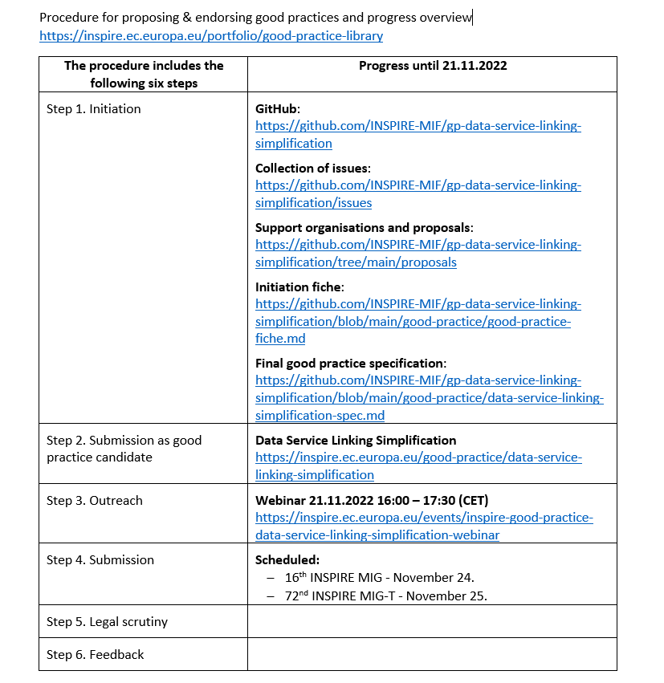
Conclusions and next steps
Data-Service Linking Simplification good practice candidate
Outreach webinar (today)
Presentation of the final good practice specification.
Implementation evidences.
Ready for MIG-T / MIG endorsement.
November 25th 2022

Slide 41

Thank you!
© European Union 2020
Unless otherwise noted the reuse of this presentation is authorised under the CC BY 4.0 license. For any use or reproduction of elements that are not owned by the EU, permission may need to be sought directly from the respective right holders.
JRC-INSPIRE-SUPPORT@ec.europa.eu

